Slide 1
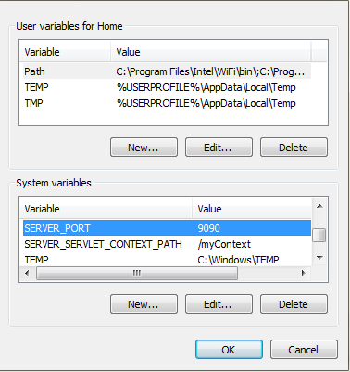
Spring Boot – How to Change Default Context Path and port using OS Environment Variable?
We can change spring boot context path and default server port by setting SERVER_CONTEXT_PATH (for Spring Boot 1.x) and SERVER_PORT respectively as OS (such as Windows and Linux) environment variables.
In Spring Boot 2.x, use SERVER_SERVLET_CONTEXT_PATH variable to change context path. I am using Windows 7. Find the steps to configure environment variables for Spring Boot 1.x.
Step 1: Right click on Computer icon then go to Properties -> Advanced System Settings -> Environment Variables and set variables as follows.

Slide 2
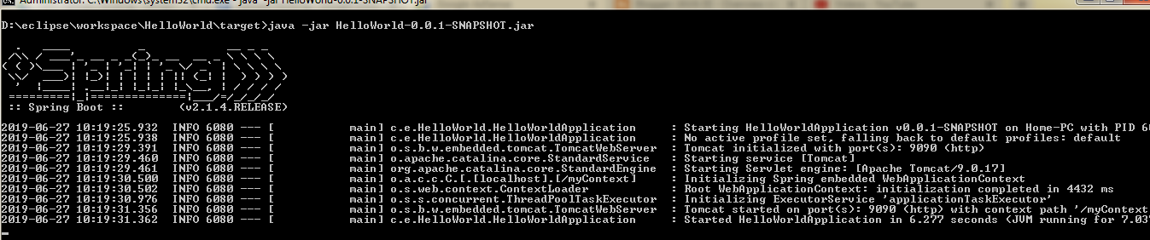
Spring Boot – How to Change Default Context Path and port using OS Environment Variable?
Open the command prompt and build the project. Suppose we get an executable JAR as
HelloWorld-0.0.1-SNAPSHOT.jar then run it using java command as follows.
java -jar HelloWorld-0.0.1-SNAPSHOT.jar
If we want to run spring boot application from eclipse console, first restart the eclipse and then run the application.

